Slide 1



Slide 2
Chapter 11 – Interfacing with the Analog World

Slide 3
Chapter 11 Objectives
Selected areas covered in this chapter:
  Theory of operation and circuit limitations of several types of digital-to-analog converters (DACs).
  Various DAC manufacturer specifications.
  Test procedures for troubleshooting DAC circuits.
  Advantages/disadvantages of major analog-to-digital converter (ADC) architectures.
  Sample-and-hold circuits in conjunction with ADCs.
  Operation of an analog multiplexing system.
  Basic concepts of digital signal processing.
Digital Systems: Principles and Applications, 11/e
Ronald J. Tocci, Neal S. Widmer, Gregory L. Moss

Slide 4
11-1 Interfacing With the Analog World
A review of the difference between digital and analog quantities:
  Digital quantities—values can take on one of two possible values.
    Actual values can be in a specified range, so exact value is not important.
  Analog quantities—values can take on an infinite number of values, and the exact value is important.
Digital Systems: Principles and Applications, 11/e
Ronald J. Tocci, Neal S. Widmer, Gregory L. Moss

Slide 5
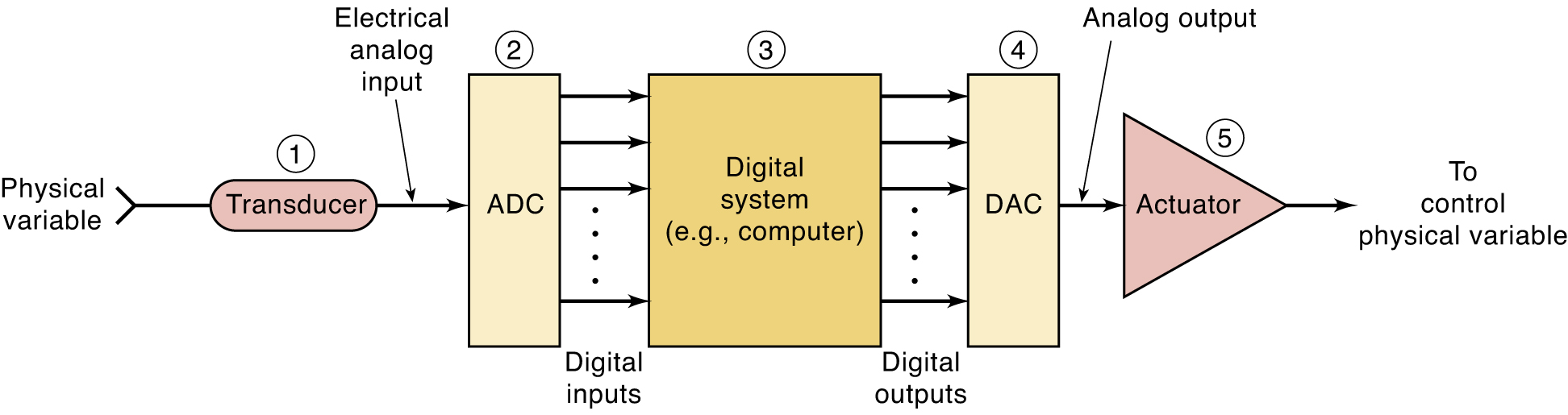
11-1 Interfacing With the Analog World
Most physical variables are analog, and can take on any value within a continuous range of values.
  Normally a nonelectrical quantity.
A transducer converts the physical variable to
an electrical variable.
  Thermistors, photo-cells, photodiodes, flow meters, pressure transducers, tachometers, etc.
Digital Systems: Principles and Applications, 11/e
Ronald J. Tocci, Neal S. Widmer, Gregory L. Moss

Slide 6
11-1 Interfacing With the Analog World
The transducer’s electrical analog output is the analog input to the analog-to-digital converter.
The ADC converts analog input to a digital output
  Output consists of a number of bits that represent the value of the analog input.
    The binary output from the ADC is proportional to the analog input voltage.
Digital Systems: Principles and Applications, 11/e
Ronald J. Tocci, Neal S. Widmer, Gregory L. Moss

Slide 7
11-1 Interfacing With the Analog World
The digital representation of the process variable
is transmitted from the ADC to the digital computer
  The digital value is stored & processes according
  to a program of instructions that it is executing.
The program might perform calculations or other operations to produce output that will eventually be used to control a physical device.
Digital Systems: Principles and Applications, 11/e
Ronald J. Tocci, Neal S. Widmer, Gregory L. Moss

Slide 8
11-1 Interfacing With the Analog World
Digital output from the computer is connected to
a digital-to-analog converter (DAC).
  Converted to a proportional analog voltage/current.
The analog signal is often connected to some device or circuit that serves as an actuator to control the physical variable.
  An electrically controlled valve or thermostat, etc.
Digital Systems: Principles and Applications, 11/e
Ronald J. Tocci, Neal S. Widmer, Gregory L. Moss

Slide 9
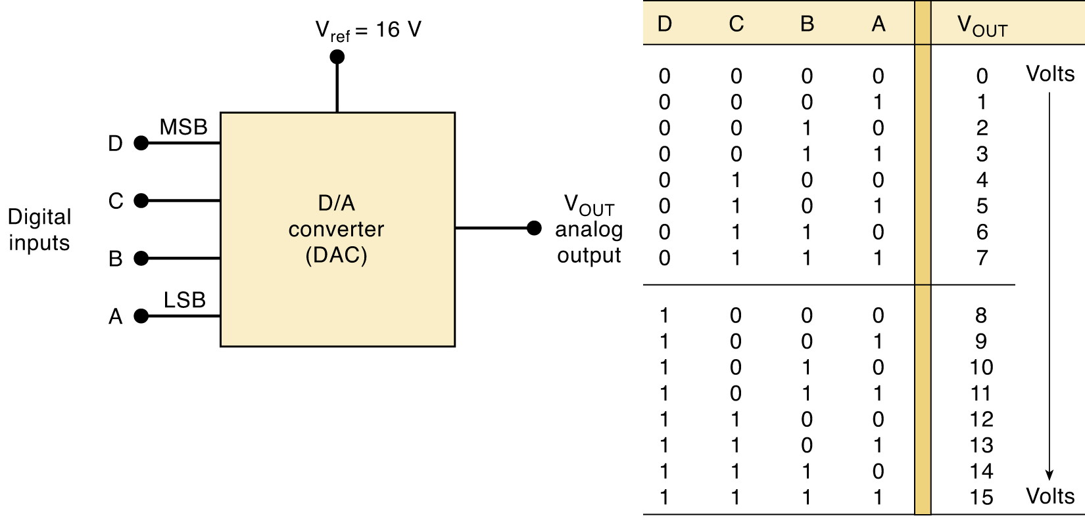
11-2 Digital to Analog Conversion
Many A/D conversion methods utilize the D/A conversion process.
  Converting a value represented in digital code to a voltage or current proportional to the digital value.
DAC output is technically not an analog quantity because it can
take on only specific values.
Digital Systems: Principles and Applications, 11/e
Ronald J. Tocci, Neal S. Widmer, Gregory L. Moss

Slide 10
11-2 Digital to Analog Conversion
For each input number, the D/A converter output voltage is a unique value—in general:
…where K is the proportionality factor and is a constant value
for a given DAC connected to a fixed reference voltage.
The quantity of possible output values can be increased, and the difference between successive values decreased—by increasing the input bits.
Allowing output more & more like an analog quantity
that varies continuously over a range of values.
A “pseudo-analog” quantity, which approximates
pure analog, referred to as analog for convenience.
Digital Systems: Principles and Applications, 11/e
Ronald J. Tocci, Neal S. Widmer, Gregory L. Moss

Slide 11
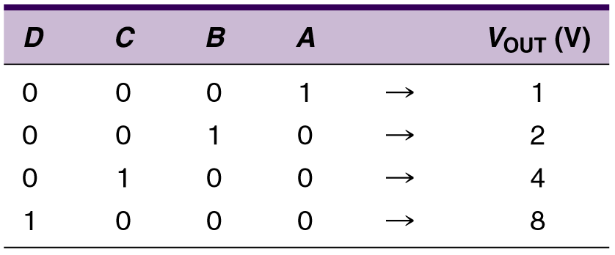
11-2 Digital to Analog Conversion
Each digital input contributes a different amount
to the analog output—weighted according to their position in the binary number.
Weights are successively doubled
for each bit, beginning with the LSB.
V_{OUT} can be considered to be the weighted sum of the digital inputs.
Digital Systems: Principles and Applications, 11/e
Ronald J. Tocci, Neal S. Widmer, Gregory L. Moss

Slide 12
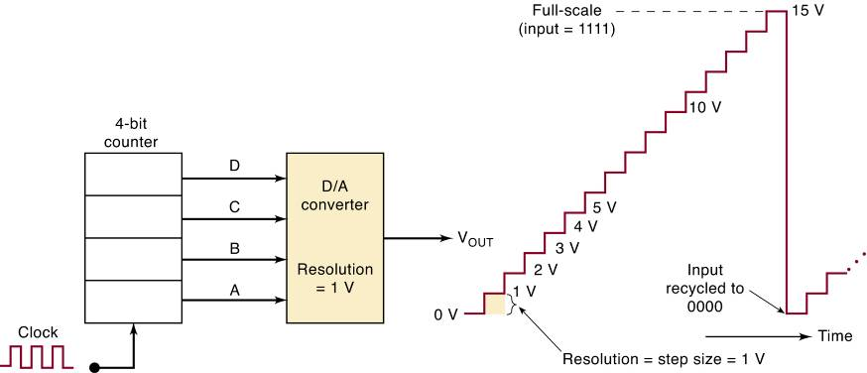
11-2 Digital to Analog Conversion
The Resolution of a D/A converter is defined
as the smallest change that can occur in analog output as a result of a change in digital input.
Always equal to the weight of the LSB, called the step size, it is the amount V_{OUT} will change as digital input value changes from one step to the next.
Digital Systems: Principles and Applications, 11/e
Ronald J. Tocci, Neal S. Widmer, Gregory L. Moss

Slide 13
11-2 Digital to Analog Conversion
Resolution (step size) is the same as the DAC input/output proportionality factor:
…where K is the proportionality factor and is a constant value
for a given DAC connected to a fixed reference voltage.
Digital Systems: Principles and Applications, 11/e
Ronald J. Tocci, Neal S. Widmer, Gregory L. Moss

Slide 14
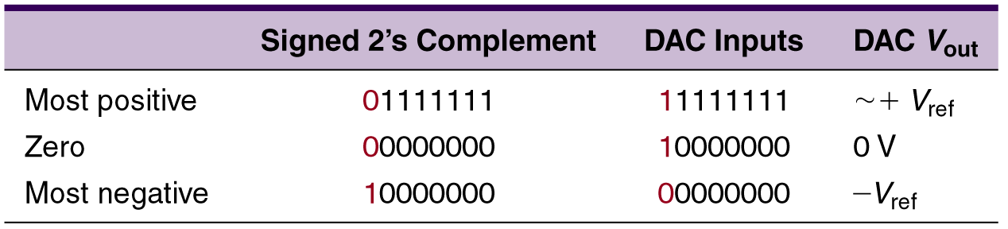
11-2 Digital to Analog Conversion
Many DACs can also produce negative voltages
by making slight changes to the analog circuitry
on the output of the DAC.
Other DACs may have the extra circuitry
built in and accept 2’s complement
signed numbers as inputs.
Digital Systems: Principles and Applications, 11/e
Ronald J. Tocci, Neal S. Widmer, Gregory L. Moss

Slide 15
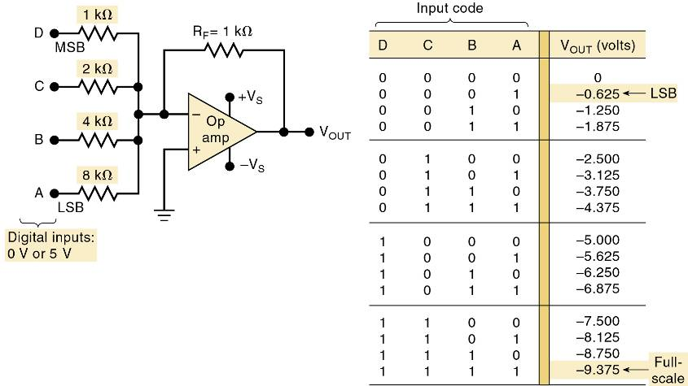
11-3 DAC Circuitry
Simple DAC using an op-amp summing
amplifier with binary-weighted resistors.
Input resistor values are binarily weighted. Starting with MSB, resistor values
increase by a factor of 2, producing
desired weighting in the voltage output.
Digital Systems: Principles and Applications, 11/e
Ronald J. Tocci, Neal S. Widmer, Gregory L. Moss

Slide 16
11-3 DAC Circuitry
How close the circuit comes to producing the ideal values of V_{OUT} depends primarily on two factors.
  The precision of the input and feedback resistors.
  The precision of the input voltage levels.
Resistors can be made very accurate by trimming.
  Within 0.01 percent of the desired values.
Digital inputs cannot be taken directly from the outputs of FFs or logic gates because the output logic levels of these vary within given ranges.
  It is necessary to add circuitry between each digital input and its input resistor to the summing amplifier.
Digital Systems: Principles and Applications, 11/e
Ronald J. Tocci, Neal S. Widmer, Gregory L. Moss

Slide 17
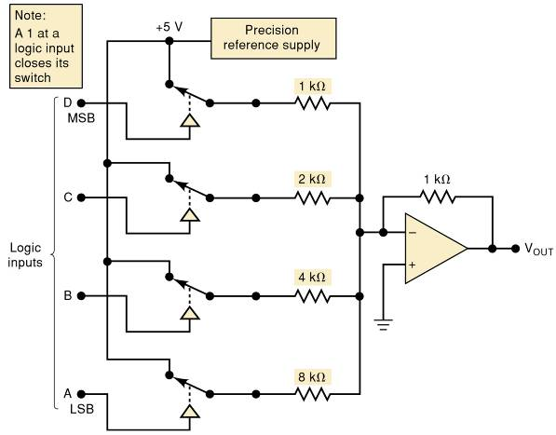
11-3 DAC Circuitry
Complete four-bit DAC including
precision reference supply.
Each digital input controls a semiconductor switch such as a CMOS transmission gate.
When input is HIGH, the switch connects
a precision reference supply to the input.
When the input is LOW,
the switch is open.
The reference supply produces a very stable, precise voltage needed for accurate analog output.
Digital Systems: Principles and Applications, 11/e
Ronald J. Tocci, Neal S. Widmer, Gregory L. Moss

Slide 18
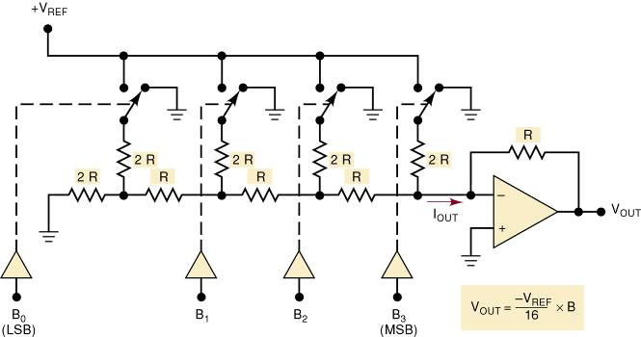
11-3 DAC Circuitry
Circuits with binary weighted resistors cause a problem due to the large difference in R values between LSB and MSB.
  The R/2R ladder uses resistances that span only
  a 2 to 1 range.
Digital Systems: Principles and Applications, 11/e
Ronald J. Tocci, Neal S. Widmer, Gregory L. Moss

Slide 19
11-4 DAC Specifications
Many DACs are available as ICs or self contained packages, and key specifications are:
  Resolution; Accuracy.
  Offset error; Settling time; Monotonicity.
Digital Systems: Principles and Applications, 11/e
Ronald J. Tocci, Neal S. Widmer, Gregory L. Moss

Slide 20
11-5 An Integrated Circuit DAC
The AD7524, a CMOS IC is an eight-bit D/A converter that uses an R/2R ladder network.
  This DAC has an eight-bit input that can be latched internally by Chip Select and WRITE inputs.
When either control input goes HIGH, the digital input data are latched, and the analog output remains at the level corresponding to that
latched digital data.
Digital Systems: Principles and Applications, 11/e
Ronald J. Tocci, Neal S. Widmer, Gregory L. Moss

Slide 21
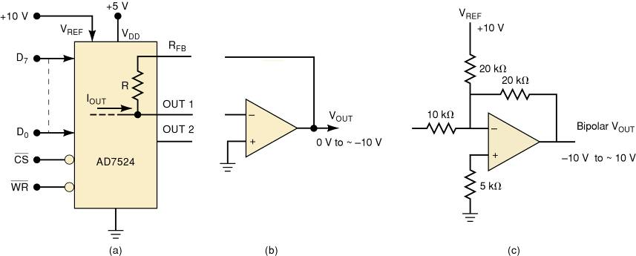
11-5 An Integrated Circuit DAC
(a) AD7524 8-bit DAC with latched inputs.
(b) Op-amp current-to- voltage converter provides 0 to
approximately -10 V out
(c) Op-amp circuit to produce bipolar output from -10 V to
approximately 10 V.
Digital Systems: Principles and Applications, 11/e
Ronald J. Tocci, Neal S. Widmer, Gregory L. Moss

Slide 22
11-6 DAC Applications
Used when a digital circuit output must provide an analog voltage or current.
  Control—use a digital computer output to adjust motor speed or furnace temperature.
  Automatic testing—computer generated signals to test analog circuitry.
  Signal reconstruction—restoring an analog signal after it has been converted to digital.
  Digital amplitude control—used to reduce the amplitude of an analog signal.
  Serial DACs—with a built-in serial in/parallel out shift register—many have more than one DAC on the same chip.
Digital Systems: Principles and Applications, 11/e
Ronald J. Tocci, Neal S. Widmer, Gregory L. Moss

Slide 23
11-7 Troubleshooting DACs
DACs are both digital and analog.
  Logic probes & pulsers can be used on digital inputs.
  A meter or an oscilloscope must be used on the analog output.
Two ways to test DAC operation:
  Static accuracy test—binary input is set to a fixed value while analog output is checked with a very accurate meter.
  Staircase test—binary input is incremented and output is checked for problems on the “steps”.
Digital Systems: Principles and Applications, 11/e
Ronald J. Tocci, Neal S. Widmer, Gregory L. Moss

Slide 24
11-8 Analog to digital Conversion
An analog-to-digital converter takes an analog input voltage and, after a certain amount of time, produces a digital output code that represents the analog input.
  Several important types of ADCs utilize a DAC as
  part of their circuitry.
The Op amp comparator ADC
  Variations differ in how the control section continually modifies numbers in the register
Digital Systems: Principles and Applications, 11/e
Ronald J. Tocci, Neal S. Widmer, Gregory L. Moss

Slide 25
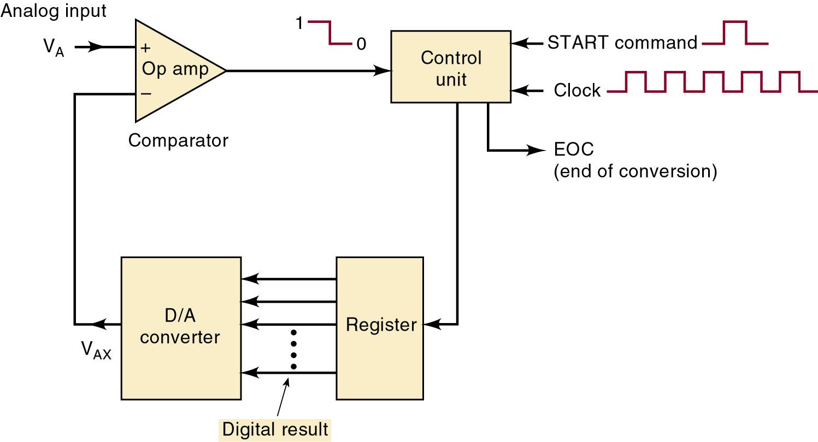
11-8 Analog to digital Conversion
General diagram of one class of ADCs.
Timing for the operation
is provided by the
input clock signal.
Digital Systems: Principles and Applications, 11/e
Ronald J. Tocci, Neal S. Widmer, Gregory L. Moss

Slide 26
11-8 Analog to digital Conversion
General diagram of one class of ADCs.
The control unit contains
the logic circuitry for generating the proper sequence of operations
Digital Systems: Principles and Applications, 11/e
Ronald J. Tocci, Neal S. Widmer, Gregory L. Moss

Slide 27
11-8 Analog to digital Conversion
General diagram of one class of ADCs.
The op-amp comparator has two analog inputs
and a digital output
that switches states, depending on which analog input is greater.
Digital Systems: Principles and Applications, 11/e
Ronald J. Tocci, Neal S. Widmer, Gregory L. Moss

Slide 28
11-8 Analog to digital Conversion
Basic operation of ADC types:
  The START command pulse initiates the operation.
  At a rate determined by the clock, the control unit continually modifies the binary number in the register.
  The binary number in the register is converted to an analog voltage (V_{AX}), by the DAC.
  The comparator compares V_{AX} with analog input V_{A}.
    While V_{AX} < V_{A} ,comparator output stays HIGH.
    When V_{AX} exceeds V_{A} by at least an amount equal to V_{T} (threshold voltage), comparator out-put goes LOW and stops modifying the register number.
  The control logic activates the end-of-conversion signal, EOC, when the conversion is complete.
Digital Systems: Principles and Applications, 11/e
Ronald J. Tocci, Neal S. Widmer, Gregory L. Moss

Slide 29
11-8 Analog to digital Conversion
One of the simplest versions of the general ADC uses a binary counter as the register and allows the clock to increment the counter one step at a time until V_{AX} > V_{A}.
  Called a digital-ramp ADC because the waveform
  at V_{AX} is a step-by-step ramp.
Digital Systems: Principles and Applications, 11/e
Ronald J. Tocci, Neal S. Widmer, Gregory L. Moss

Slide 30
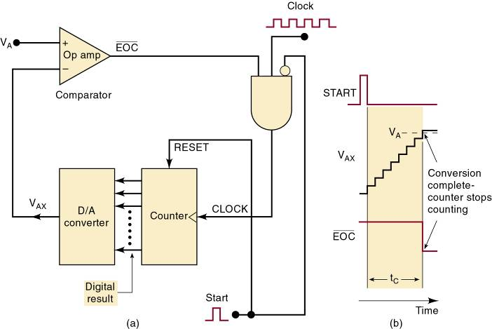
11-9 Digital Ramp ADC
Digital-ramp ADC
Digital Systems: Principles and Applications, 11/e
Ronald J. Tocci, Neal S. Widmer, Gregory L. Moss

Slide 31
11-9 Digital Ramp ADC
A/D resolution and accuracy.
  Measurement error is unavoidable.
  Reducing the step size can reduce but not eliminate potential error—called quantization error.
Digital Systems: Principles and Applications, 11/e
Ronald J. Tocci, Neal S. Widmer, Gregory L. Moss

Slide 32
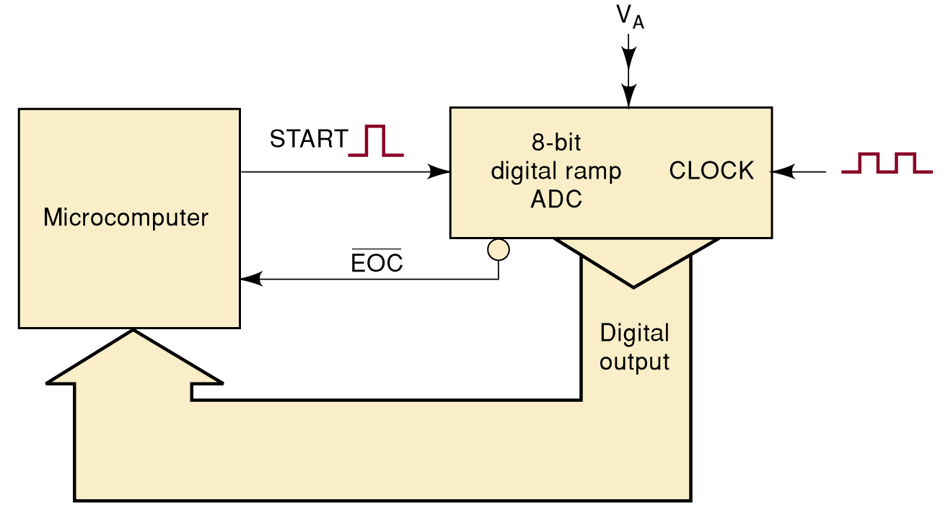
11-10 Data Acquisition
11-9 Digital Ramp ADC
The process by which the computer acquires digitized analog data is called data acquisition.
Acquiring a single data point’s value is
referred to as sampling the analog signal.
  That data point is often called a sample.
Microcomputer connected
to a digital-ramp ADC
for data acquisition.
Digital Systems: Principles and Applications, 11/e
Ronald J. Tocci, Neal S. Widmer, Gregory L. Moss

Slide 33
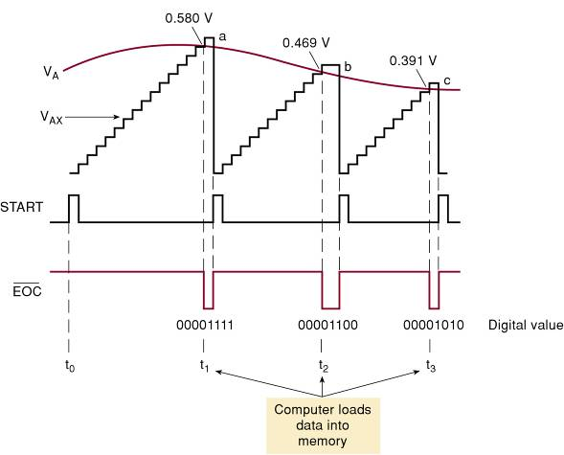
11-10 Data Acquisition
11-9 Digital Ramp ADC
The waveforms illustrate how the computer acquires digital version of the analog signal (V_{A} ).
Digital Systems: Principles and Applications, 11/e
Ronald J. Tocci, Neal S. Widmer, Gregory L. Moss

Slide 34
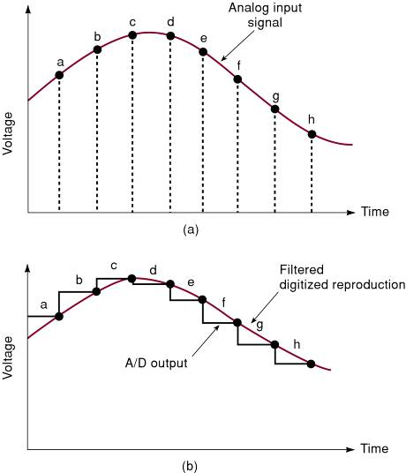
11-10 Data Acquisition
Digitizing an
analog signal.
Reconstructing
the signal from
the digital data.
Digital Systems: Principles and Applications, 11/e
Ronald J. Tocci, Neal S. Widmer, Gregory L. Moss

Slide 35
11-10 Data Acquisition
The goal in signal reconstruction is to make the reconstruction nearly identical to the original analog signal.
To avoid loss of information, the incoming signal must be sampled at a rate greater than two times the frequency component in the incoming signal.
  Proven by a man named Harry Nyquist.
The frequency at which samples are taken is referred to as the sampling frequency (F_{S}).
Digital Systems: Principles and Applications, 11/e
Ronald J. Tocci, Neal S. Widmer, Gregory L. Moss

Slide 36
11-10 Data Acquisition
Consider sampling a 10-kHz frequency, at 20,000 samples/sec.
  If, for example a 12-kHz tone were present in the input signal, a phenomenon called aliasing would occur.
  A signal alias is produced by sampling at less than
  the minimum rate—in this case, 24,000 samples/sec.
    The alias frequency is always the difference between any integer multiple of the sampling frequency and
    the incoming frequency being digitized.
Digital Systems: Principles and Applications, 11/e
Ronald J. Tocci, Neal S. Widmer, Gregory L. Moss

Slide 37
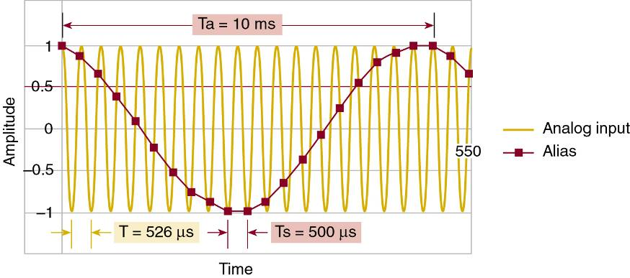
11-10 Data Acquisition
An alias signal due to undersampling.
Digital Systems: Principles and Applications, 11/e
Ronald J. Tocci, Neal S. Widmer, Gregory L. Moss

Slide 38
11-11 Successive Approximation ADC
The successive-approximation converter is one of the most widely used types of ADC.
  It has more complex circuitry than the digital-ramp ADC but a much shorter conversion time.
    A fixed value of conversion time not dependent
    on the value of the analog input.
Digital Systems: Principles and Applications, 11/e
Ronald J. Tocci, Neal S. Widmer, Gregory L. Moss

Slide 39
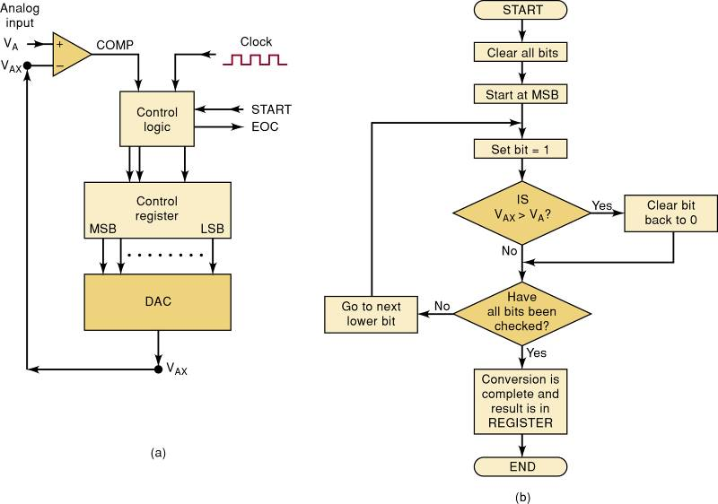
11-11 Successive Approximation ADC
Successive-approximation ADC.
Digital Systems: Principles and Applications, 11/e
Ronald J. Tocci, Neal S. Widmer, Gregory L. Moss

Slide 40
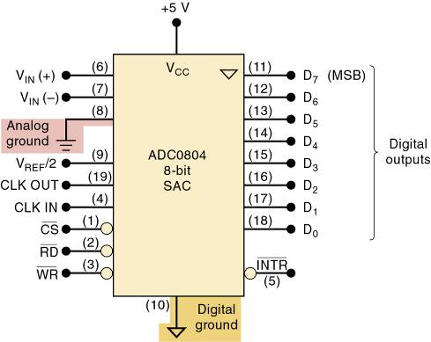
11-11 Successive Approximation ADC
ADCs are available with a wide range of operating characteristics and features.
  The ADC0804 is a 20-pin CMOS IC that performs
  A/D conversion using successive approximation.
It has two analog inputs,
to allow differential inputs.
It converts differential analog
input voltage to an eight-bit
tristate buffered digital output.
Internal clock generator circuit
that produces a frequency
based on values of externally connected components.
Separate ground connections for digital and analog voltages.
Digital Systems: Principles and Applications, 11/e
Ronald J. Tocci, Neal S. Widmer, Gregory L. Moss

Slide 41
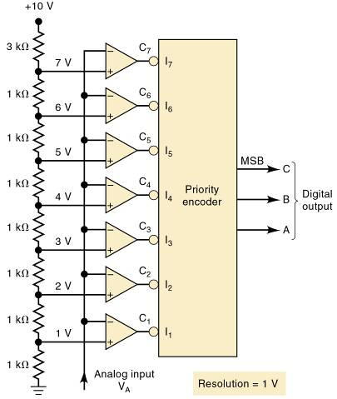
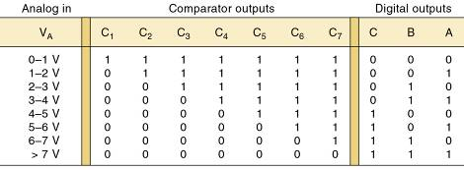
11-12 Flash ADCs
The flash converter is the highest-speed ADC.
  Requires much more circuitry than the other types.
IC flash converters are commonly available in two- to eight-bit units,
and nine- and ten-bit units.
Digital Systems: Principles and Applications, 11/e
Ronald J. Tocci, Neal S. Widmer, Gregory L. Moss

Slide 42
11-12 Flash ADCs
Flash converters use no clock signal because no timing or sequencing is required.
  The conversion takes place continuously.
When analog input value changes, comparator outputs change—causing encoder output change.
  Conversion time depends only on the propagation delays of the comparators and encoder logic.
Flash converters can be very expensive and tend to have relatively low resolutions and high power consumption.
Digital Systems: Principles and Applications, 11/e
Ronald J. Tocci, Neal S. Widmer, Gregory L. Moss

Slide 43
11-13 Other A/D Conversion Methods
There are many other methods of A/D conversion.
  The dual-slope converter has one of the slowest conversion times (typically 10 to 100 ms).
    Relatively low cost—no precision components.
  The voltage-to-frequency ADC is simpler than
  other ADCs because it does not use a DAC.
    A linear voltage-controlled oscillator (VCO) produces
    an output frequency proportional to input voltage.
  A sigma/delta modulation converter is an over-sampling device.
    It effectively samples the analog information more
    often than the minimum sample rate.
  A pipelined ADC has two or more subranging stages.
    Each with an n-bit ADC along with an n-bit DAC.
Digital Systems: Principles and Applications, 11/e
Ronald J. Tocci, Neal S. Widmer, Gregory L. Moss

Slide 44
11-14 Typical ADC Architecture for Applications
Most ADC applications fall into one of four areas:
  Precision industrial measurement.
  Voice/audio.
  Data acquisition.
  High speed.
Digital Systems: Principles and Applications, 11/e
Ronald J. Tocci, Neal S. Widmer, Gregory L. Moss

Slide 45
11-15 Sample and Hold Circuits
Analog voltage connected directly to an ADC input conversion can be adversely affected if analog voltage is changing during the conversion time.
Stability of conversion can be improved by using
a sample-and-hold (S/H) circuit.
  To hold the analog voltage constant while the A/D conversion is taking place.
In a computer-controlled data acquisition system the sample-and-hold switch would be controlled by a digital signal from the computer.
  The amount of time the switch would have to remain closed is called the acquisition time
Digital Systems: Principles and Applications, 11/e
Ronald J. Tocci, Neal S. Widmer, Gregory L. Moss

Slide 46
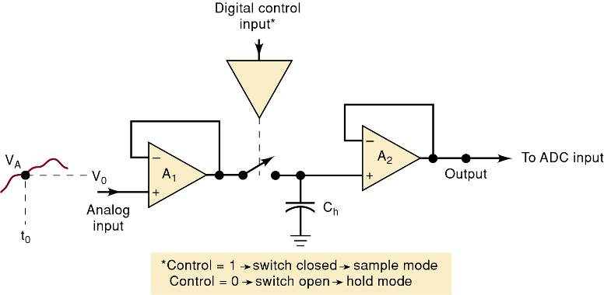
11-15 Sample and Hold Circuits
Simplified diagram of a sample-and-hold circuit.
Digital Systems: Principles and Applications, 11/e
Ronald J. Tocci, Neal S. Widmer, Gregory L. Moss

Slide 47
11-16 Multiplexing
When analog inputs from several sources are to be converted, a multiplexing technique can be used so that one ADC may be time-shared.
Digital Systems: Principles and Applications, 11/e
Ronald J. Tocci, Neal S. Widmer, Gregory L. Moss

Slide 48
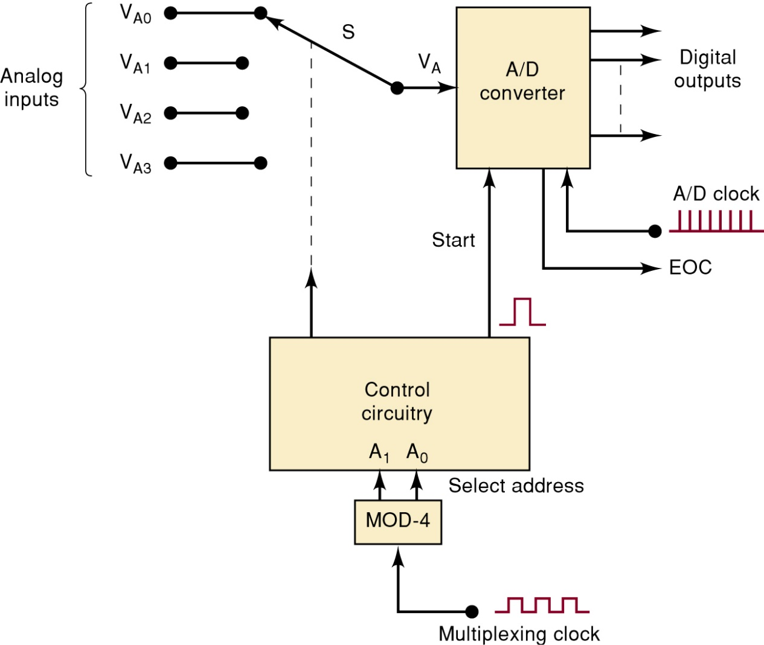
11-16 Multiplexing
Conversion of four analog inputs by
multiplexing through one ADC.
The multiplexing clock controls the
rate at which the analog signals are sequentially switched into the ADC.
Switch delay time can be minimized
by using semiconductor switches.
Digital Systems: Principles and Applications, 11/e
Ronald J. Tocci, Neal S. Widmer, Gregory L. Moss

Slide 49
11-16 Multiplexing
Conversion of four analog inputs by
multiplexing through one ADC.
Many integrated ADCs contain
the multiplexing circuitry on the
same chip as the ADC.
The ADC0808 can multiplex eight different analog inputs into one ADC.
Digital Systems: Principles and Applications, 11/e
Ronald J. Tocci, Neal S. Widmer, Gregory L. Moss

Slide 50
11-17 Digital Signal Processing (DSP)
A digital signal processor (DSP) is a very specialized form of microprocessor, optimized
to perform repetitive calculations on streams of digitized data.
  Digitized data are usually fed to the DSP from an
  A/D converter.
A major application for DSP is filtering/conditioning of analog signals.
  The advantage of DSP over resistors and capacitors
  is the flexibility of being able to change the critical frequency without switching any components.
Digital Systems: Principles and Applications, 11/e
Ronald J. Tocci, Neal S. Widmer, Gregory L. Moss

Slide 51
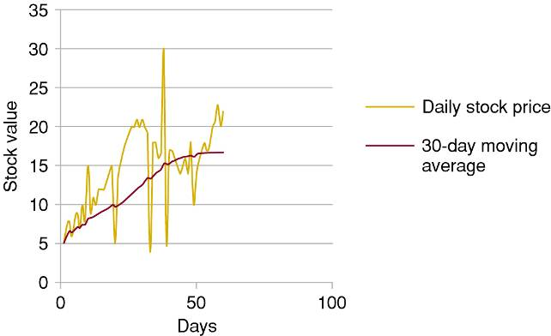
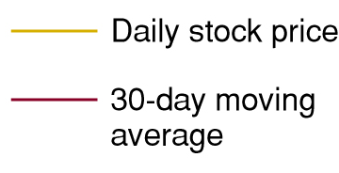
11-17 Digital Signal Processing (DSP)
To understand digital filtering, consider the buying and selling of stock.
  To decide when to buy and sell, you need to know what the market is doing.
You want to ignore sudden, short-term (high-frequency) changes
but respond to overall trends
(30-day averages).
Digital Systems: Principles and Applications, 11/e
Ronald J. Tocci, Neal S. Widmer, Gregory L. Moss

Slide 52
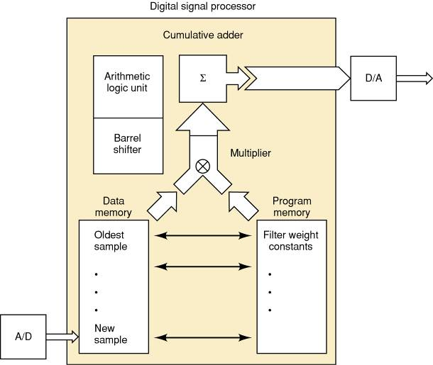
11-17 Digital Signal Processing (DSP)
The basic architecture of a DSP.
The multiply and accumulate (MAC) section is central
to all DSPs, and used
in most applications.
Digital Systems: Principles and Applications, 11/e
Ronald J. Tocci, Neal S. Widmer, Gregory L. Moss

Slide 53
11-17 Digital Signal Processing (DSP)
Digital filtering process—weighted average.
  Read the newest sample.
  Replace the oldest sample with the new one.
  Multiply each of the 256 samples by corresponding weight constant.
  Add all products.
  Output the resulting sum of products to the D/A.
Digital Systems: Principles and Applications, 11/e
Ronald J. Tocci, Neal S. Widmer, Gregory L. Moss

Slide 54
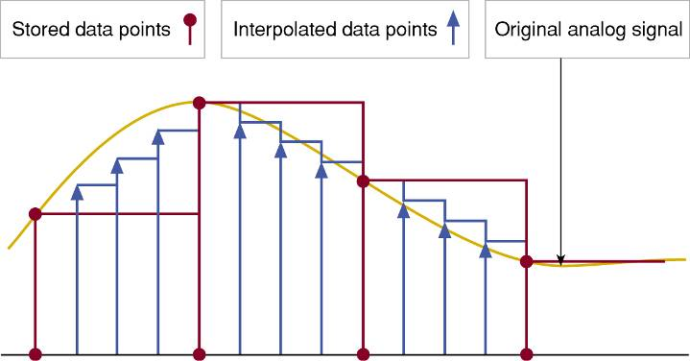
11-17 Digital Signal Processing (DSP)
Another useful application of DSP is called oversampling or interpolation filtering.
  Inserting interpolated data points into a digital
  signal to reduce noise.
Digital Systems: Principles and Applications, 11/e
Ronald J. Tocci, Neal S. Widmer, Gregory L. Moss

Slide 55
11-17 Digital Signal Processing (DSP)
DSP applications:
  Filters in CD players to minimize quantization noise.
  Echo canceling in telephone systems.
  PC modems.
  Musical instrument special effects.
  Digital television.
  Voice recognition.
Digital Systems: Principles and Applications, 11/e
Ronald J. Tocci, Neal S. Widmer, Gregory L. Moss

Slide 56
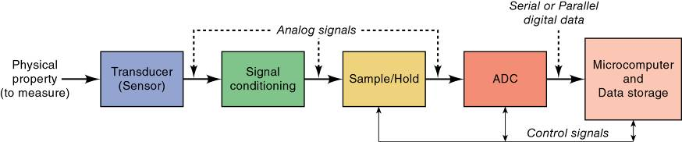
11-18 Applications of Analog Interfacing
Block diagram of a data acquisition system.
Digital Systems: Principles and Applications, 11/e
Ronald J. Tocci, Neal S. Widmer, Gregory L. Moss

Slide 57
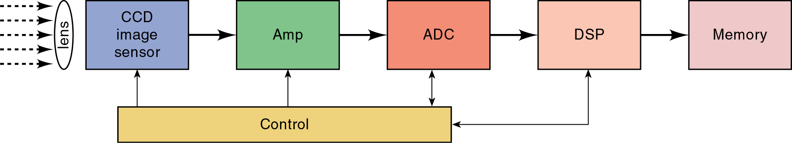
11-18 Applications of Analog Interfacing
A familiar application that interfaces analog devices to a digital system is a digital camera.
  Transducer typically a charge-coupled device (CCD).
Analog signals are read out of the CCD by shifting the electric charges through successive capacitors under the control of drivers and timing circuits.
  Amplified (signal conditioning) and then digitized by the ADC.
Digital Systems: Principles and Applications, 11/e
Ronald J. Tocci, Neal S. Widmer, Gregory L. Moss

Slide 58
11-18 Applications of Analog Interfacing
The DSP block applies image signal-processing algorithms to the digital data before storing the information in a memory device.
  Data are usually compressed.
Data compression is the process of encoding information with fewer bits representing the data.
  Only works when both the sender and receiver of the information understand the specific encoding scheme.
Digital Systems: Principles and Applications, 11/e
Ronald J. Tocci, Neal S. Widmer, Gregory L. Moss

Slide 59
END

